Slide 1
~ 8.1 FLOOD ~
Pei Sun Loh
Ocean College, Zhejiang University
18th June 2026

Slide 2
CONTENTS
Bangladesh
Impacts of climate change and human activities
Impacts of flood on hydrological cycle, carbon cycle

Slide 3
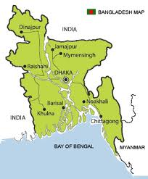
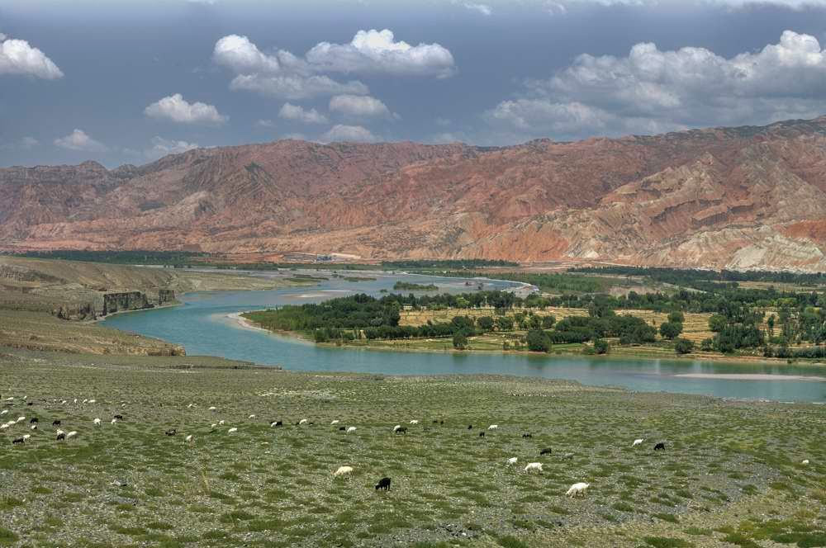
BANGLADESH – a case study
Bangladesh is a flood prone country
A tropical monsoon zone, prone to attacks of cyclones
Flooding due to tropical cyclones is the most devastating natural hazards in Bangladesh
80% of the country consist of low-lying alluvial plain of the deltas of the Ganges, Brahmaputra and Meghna Rivers
Karim and Mimura (2008)
Alluvial plain

Slide 4
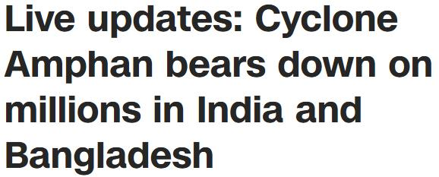
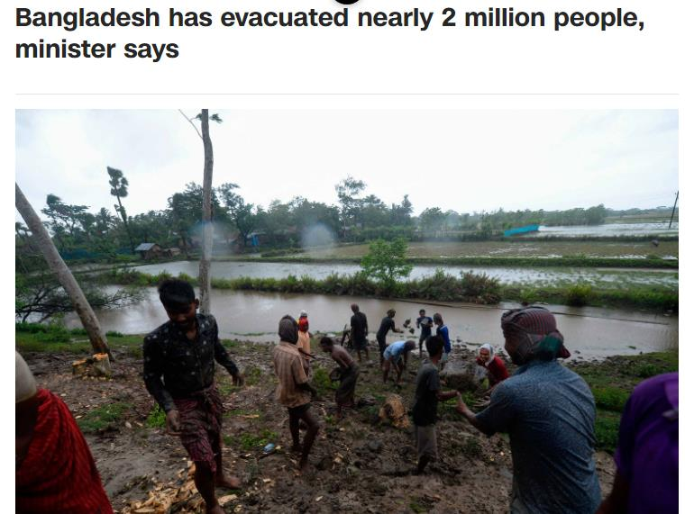
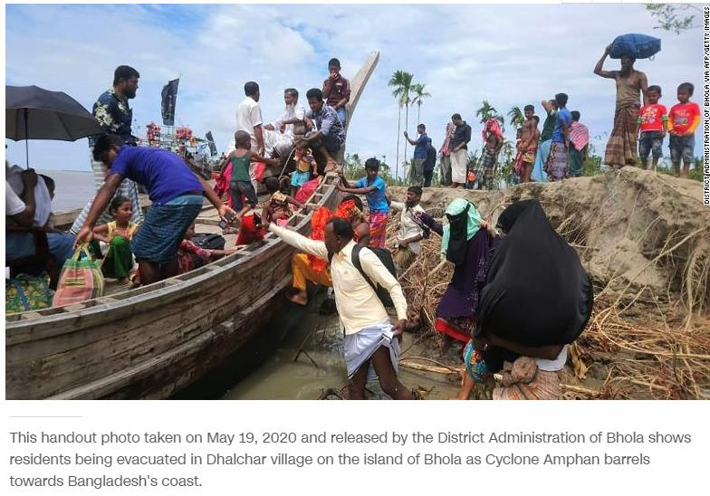

Slide 5
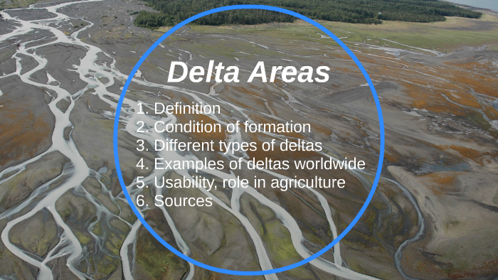
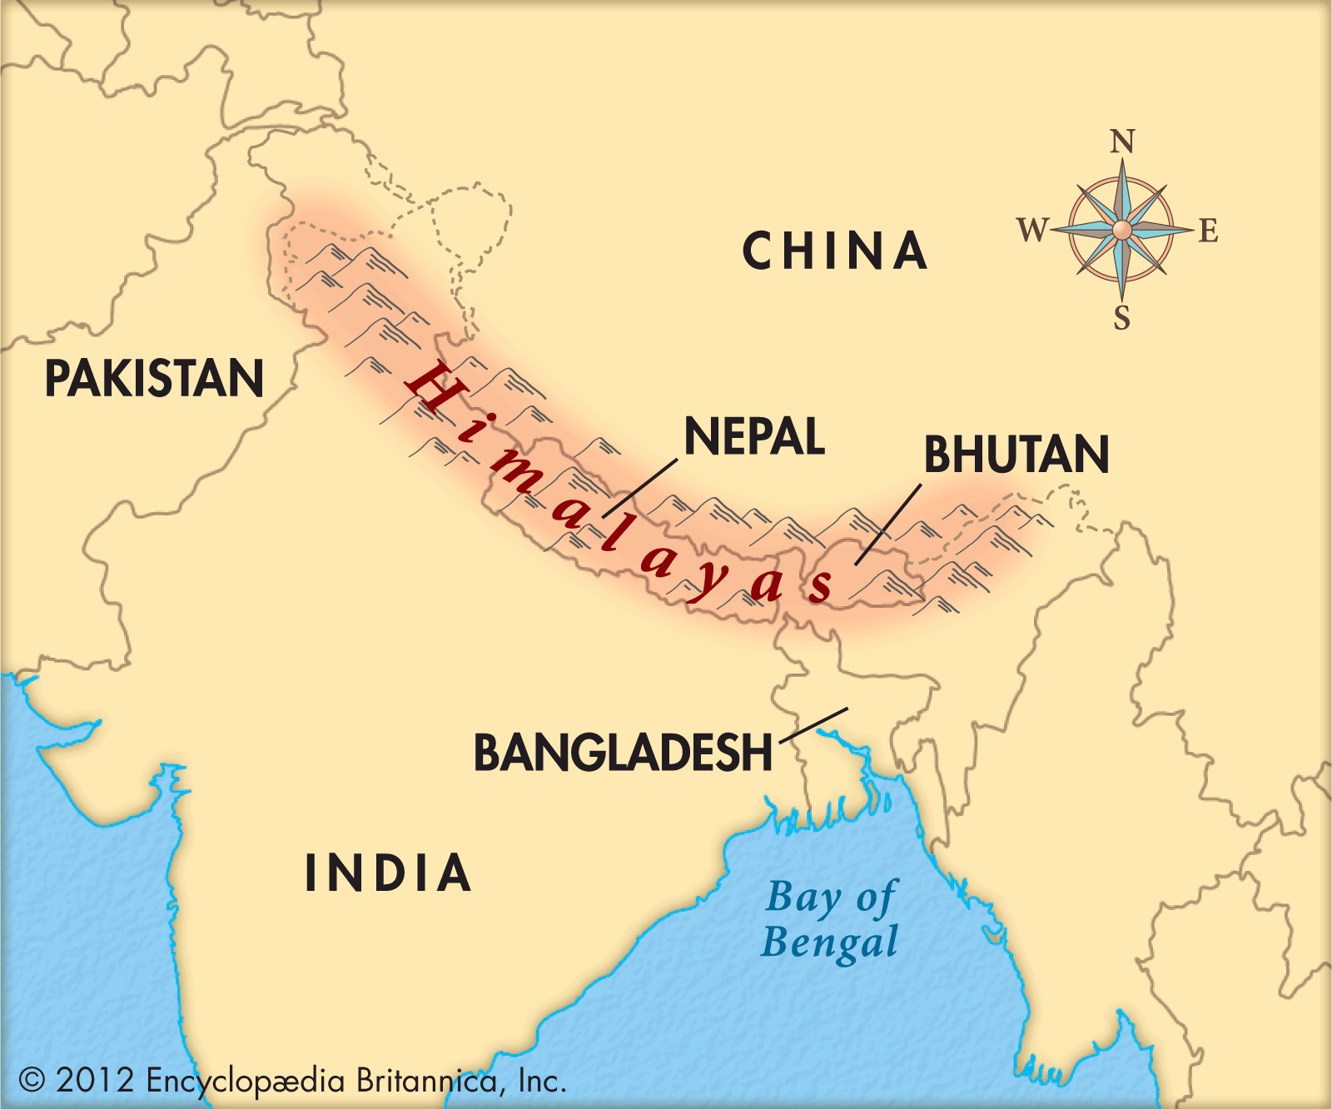
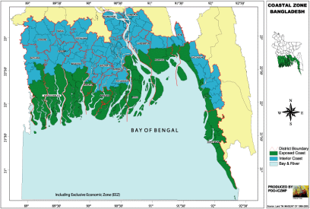
Himalayan range to the north
Low land: Low-lying deltaic plain
Wide rivers & large estuaries
Allow sea surges to intrude further
Karim and Mimura (2008)

Slide 6

Sea level rise ……..
Profound throughout the west coast, which is low lying & the land subsiding
Causes decrease of shelter heights with respect to mean sea level
Causes increase flooding

Slide 7
Impact of climate change and sea level rise ..

Slide 8
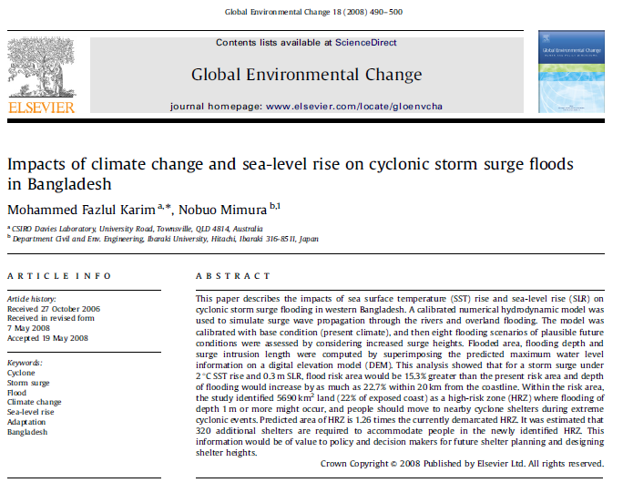

Slide 9
This paper determined the impact of sea surface T and sea-level rise on cyclonic storm surges by using some hydrodynamic model
2°C SST rise & 0.3 m SLR will cause 15.3% increase flood risk
They predicted 1.26 times more of high-risk zone (HRZ) than the currently HRZ
They estimated 320 additional shelters are needed

Slide 10
Floods - effects on human health …..

Slide 11
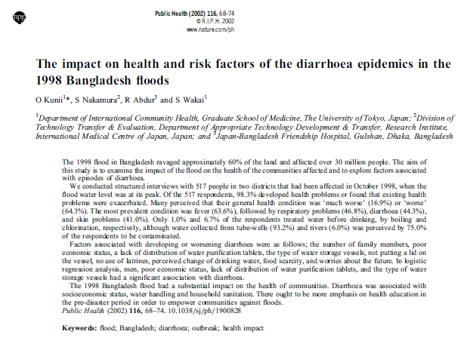

Slide 12
The 1998 flood in Bangladesh destroyed 60% of the land and affected > 30 million people
This paper studied the impact of flood on the health of the communities
Health condition worsened
They identified some most common conditions as: fever, respiratory problems, diarrhea, skin problems
The most prevalent condition was fever (63.6%), followed by respiratory problems (46.8%), diarrhoea (44.3%), skin problems (41.0%).
75% of the water was contaminated, but only about 1% to 6.7% of the respondents treated water before drinking

Slide 13
Factors associated with worsening diarrhea conditions:
Higher number of family members
Poor economic status
Lower education level
Lack of clean water; lack of water purification tablet
Food scarcity

Slide 14
Floods - effects on agricultural wages …..

Slide 15
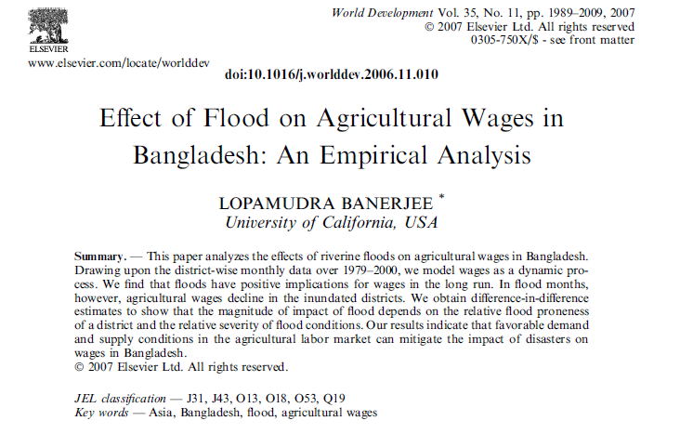

Slide 16
In flood months, agricultural wages decline
due to decline in consumption and employment
However, over the long term, flood has positive impact on agricultural wages
above than normal harvest post-flood; increased productivity
increase demand for labors

Slide 17
RESPONSES - coastal embankment …

Slide 18
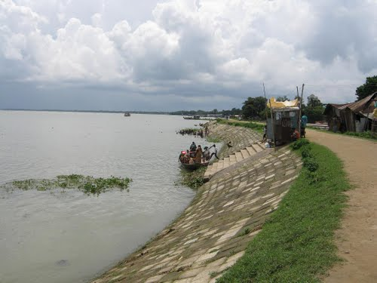
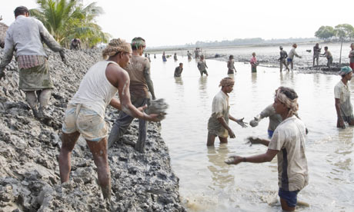
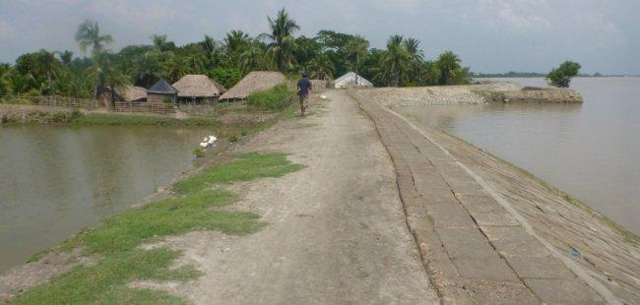
Pictures from Google

Slide 19
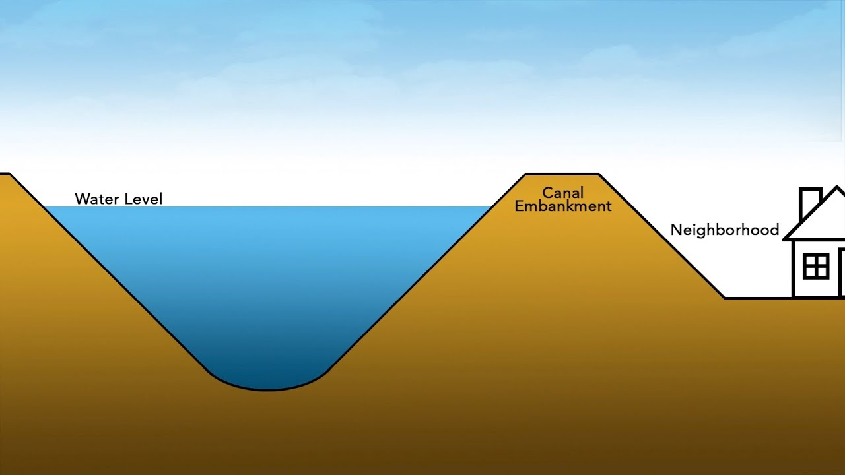
Coastal embankment projects were initiated in the 1960s by the Bangladesh governments for the following purposes:
prevent cyclonic or storm-surge flooding
increase crop production by preventing intrusion of ocean water
Choudhury et al. (2004) Applied Geography 24.

Slide 20
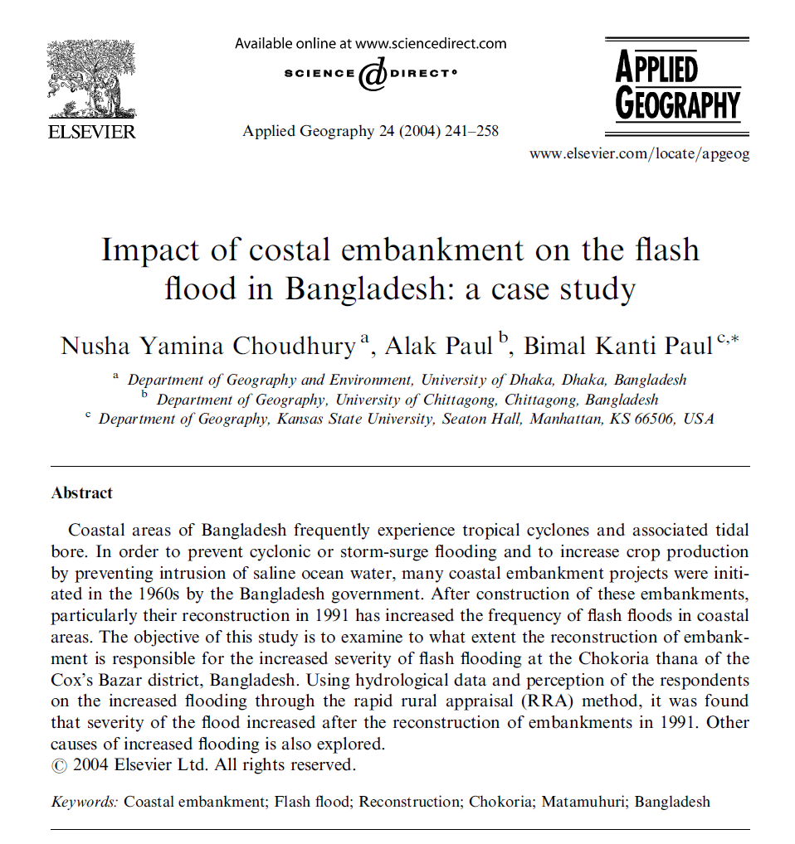

Slide 21
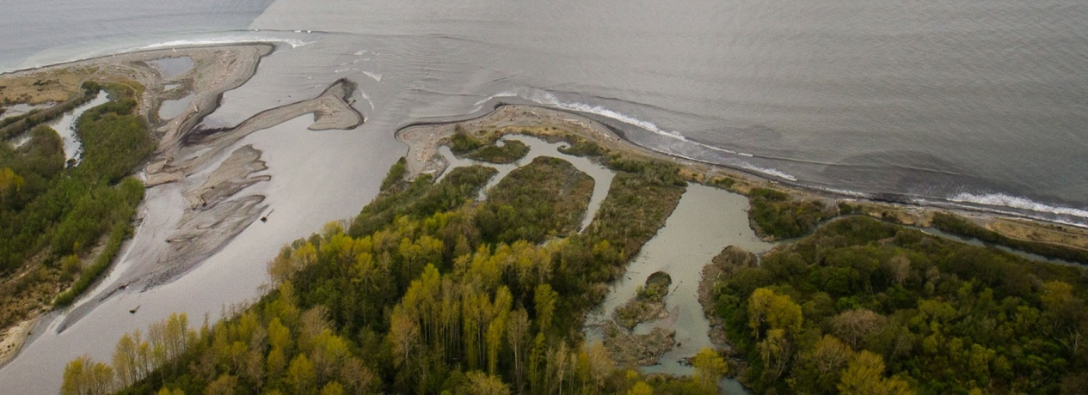
Embankments have increased the frequency of flash flooding
Building of embankments have caused obstruction of flow in the rivers
The lower reaches of the rivers cannot contain the runoff and silts coming downstreams

Slide 22
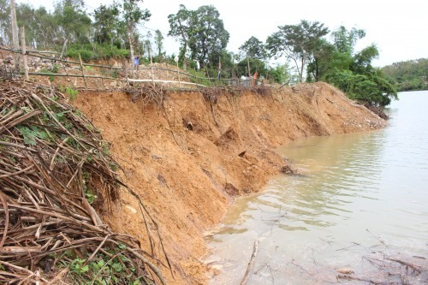
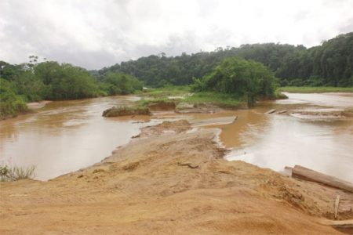
Causes of increased flash floods
Deforestation at the upstream river
Depletion of forest due to conversion of forest to shrimp cultivation ponds
Deforestation causes soil erosion & excess runoff
Siltation has increased river beds & blocked channels
Some rivers unable to contain the flow of water

Slide 23
RESPONSES - The Open Approach …

Slide 24
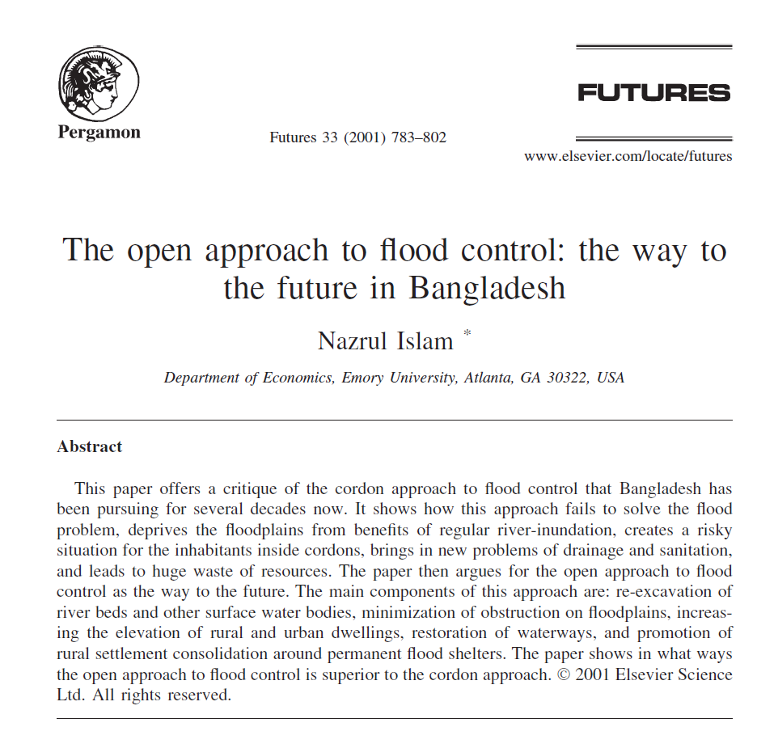

Slide 25
Some problems :
Global warming is causing more evaporation from the Indian Ocean; more moisture during the monsoon; increase precipitation
Global warming is also causing more snow melt from the Himalaya
Global warming also causes gradual rise in sea level
High sea level causes slow pace of recession of flood

Slide 26
More deforestation and topsoil exposure in the Himalaya:
More erosion
More silt in the rivers
Causes rivers to become swollen: eventually riverbeds become higher than the floodplains
Higher sea level prevent water from flowing quickly to the sea

Slide 27
The cordon approach:
Under this approach, areas were cordoned off to protect them from flooding
Constructed to protect cities
The idea was to let the river water remain contained only to their channels and pass directly to the sea

Slide 28
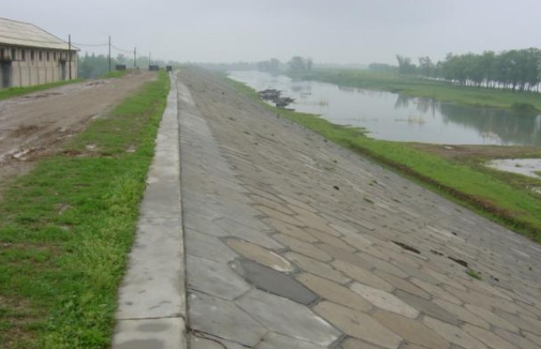
The cordon approach:
Bring a false sense of dryness – people started to construct houses without elevating the land
Water has to find place elsewhere; thus increasing pressure in neighbouring cities
Farmers are tearing down cordons of neighboring areas

Slide 29
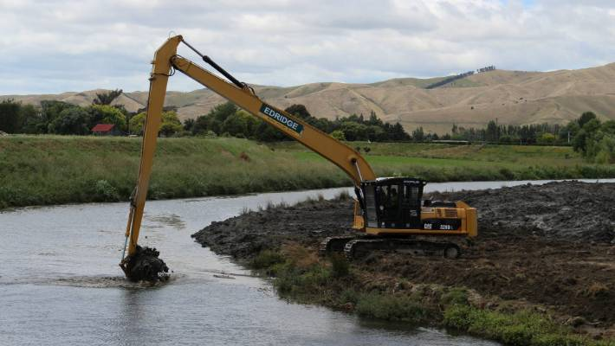
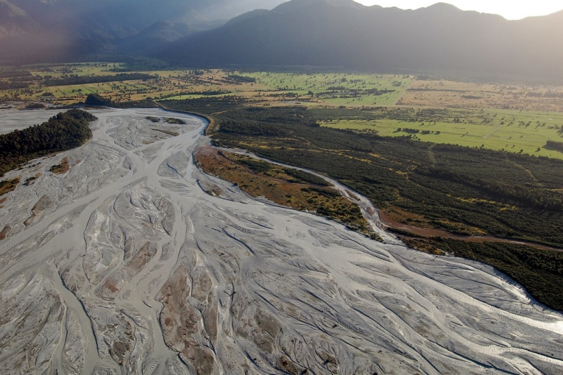
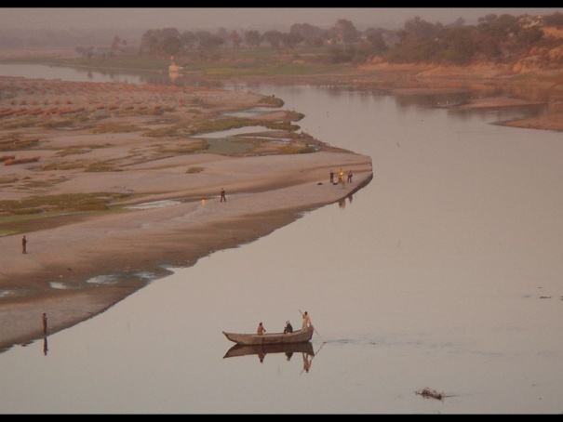
The open approach - future:
Re-excavation and dredging
This will keep riverbeds wide and deep so that peak season flow can pass easily and rapidly
Ensure free passage of water across floodplains
Dry season, people walk on the floodplain; during rainy season, use boats
New roads constructed only if necessary

Slide 30
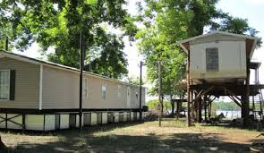
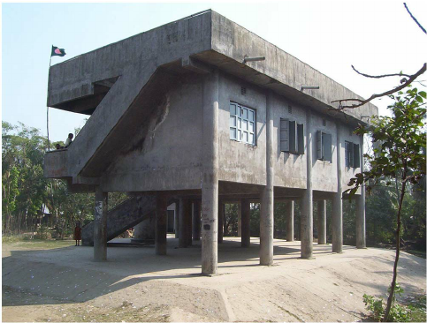

The open approach - future:
Adjustment of settlements
Elevating the ground level
Cluster: it is easier to save dwellings if they are concentrated
Open embankments
The purpose is to regulate inundation, not to prevent inundation
These will allow river water to flow into adjoining floodplains through floodgates

Slide 31
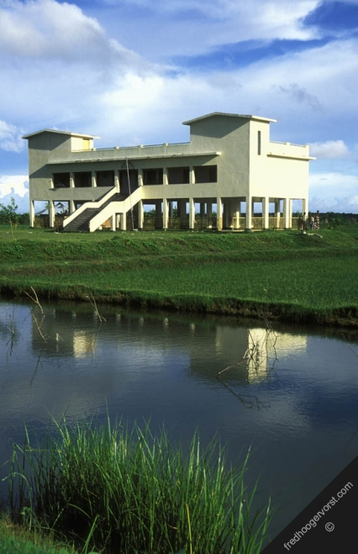
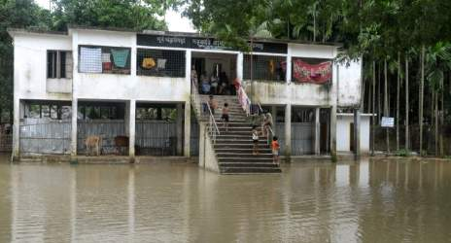
The open approach - future:
Based on the time-honored principle of the Bangladeshi ancestors
~ live with the rivers and benefit from them ~

Slide 32
SUMMARY

Slide 33
Causes of flooding in Bangladesh
Natural
Natural

Slide 34
Causes of flooding in Bangladesh
Human activities
Climate change

Slide 35
References
Banerjee L. 2007. Effect of flood on agricultural wages in Bangladesh: and empirical analysis. World Development 35 (11), 1989-2009.
Choudhury et al. 2014. Impact of coastal embankment on the flash flood in Bangladesh: a case study. Applied Geography 24, 241-258.
Dalzell et al. 2007. The role of hydrology in annual organic carbon loads and terrestrial organic matter export from a midwestern agricultural watershed. Geochimica et Cosmochimica Acta 71, 1448-1462.
Gebremichael et al. 2017. Flood-related increases in CO₂ and N₂O emissions from a temperate coastal grassland ecosystem. Biogeosciences 14, 2611-2626.

Slide 36
Islam N. 2001. The open approach to flood control: the way to the future in Bangladesh. Futures 33, 783-802.
Kanii et al. 2002. The impact on health and risk factors of the diarrhoea epidemics in the 1998 Bangladesh floods. Public Health 116, 68-74.
Karim MF and Mimura N. 2008. Impacts of climate change and sea-level rise on cyclonic storm surge floods in Bangladesh. Global Environmental Change 18, 490-500.
Stagl et al. 2013. Chapter 3. Effects of climate change on the hydrological cycle in central and eastern Europe. In“Managing protected areas in central and eastern Europe under climate change”(Rannow A and Neubert M, editors). Advances in Global Climate Research 58, 31-44pp.

Slide 37
Tesi et al. 2008. Changes in the composition of organic matter from prodeltaic sediments after a large flood event (Po River, Italy). Geochimica et Cosmochimica Acta 72, 2100-2114.
Tran et al. 2008. Catastrophic flood and forest cover change in the Huong river basin, central Viet Nam: a gap between common perceptions and facts. Journal of Environmental Management 91, 2186-2200.
Trenberth KE. 2005.The impact of climate change and variability on heavy precipitation, floods, and droughts. Encyclopedia of Hydrological Sciences (Anderson MG, ed.) 11 pp.
Voynova et al. 2017. Extreme flood impact on estuarine and coastal biogeochemistry: the 2013 Elbe flood. Biogeosciences 14, 541-557.

Slide 38
THANK YOU

